Slide 1
WI：SLB-mmW meeting # Use cases
Date: 2024-11-19
Source:
Affiliation | Contact | Email
Huawei Technologies. Co. Ltd | Xu Li | lixu11@huawei.com

Slide 2
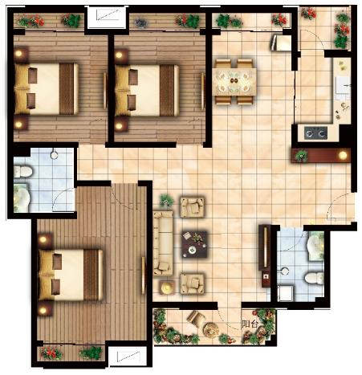

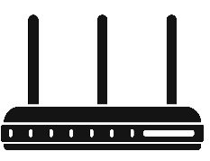
Usage Model 1: Fiber to the Room (FTTR)
Pre-Conditions:
mobile operators are updating their service for its customers at home from FTTD (fiber to the door) to FTTR (fiber to the room). User has short-range connectivity between a portable/mobile device (e.g., tablet, smart phone) and a fixed device (e.g., AP).
Application:
Users in different adjacent rooms/offices can download mass data (e.g. video/audio clip, e-magazine, picture library etc.) from a fixed device. 100 jpeg (picture) files of 5MB takes 0.6 second over a single hop 10Gbps link.
Latency 1-10 ms may be acceptable. More than 10 ms may not be acceptable.
Environment:
Environments can be variable, e.g., bed room, living room, office.
Each room has its own AP with a connection to the gateway by fiber, all APs forming one network
Natural LOS: AP deployed in each room, penetration loss becomes negligible within this room
Fiber infrastructure, with easy deployment, is able to provide more than 10 Gbps
Link distance can typically be up to 5 m.
Typically transmissions are Line of Sight.
All devices will typically be stationary during usage.
Traffic Conditions:
One or more devices in different adjacent rooms/offices can access to different SLM interfaces to form a service set. Multiple links and data streams have varying QoS, reliability, and throughput requirements, some with simply best-effort rates (downloading), others with a certain data rate and QoS requirements(video, VoIP, etc.)
Data steam can be broadcast (one point to multiple point).
Interference among different rooms/offices should be managed carefully
Use Case:
One or more communication links are set up between user devices and SLM interfaces.
Slave FTTR
Slave FTTR
fiber
Slave FTTR
Master FTTR
3 or more WLAN hotspots (all-optical WLAN)

Slide 3
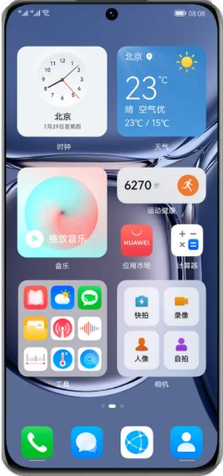
Usage Model 1: Fiber to the Room (FTTR)
Mmwave becomes a very promising band for this FTTR service, since its transmission range is short and the OBSS interference could be significantly reduced (the penetration losses of walls of each room can be high).
mmwave can mitigate interference from a different room while providing high throughput in a LOS environment within one room
Mobility/roaming within the home can also be supported well with help from the sub 7 GHz connection in this network
Pain points of the Multi-AP solution
AP1
With mmwave of Interference mitigation
Sometimes, two rooms are close to each other, but a single AP cannot cover the two rooms. In this case, interference exists between the two APs. As a result, the air interface bandwidth usage between STA1 and STA2 is low.
AP1
STA1
STA1
After interference mitigation:
The bandwidth between AP1 and AP2 is not affected, and AP1 and AP2 use the air interface independently .
AP2
AP2
STA2
STA2

Slide 4
Usage Model 2: Kiss connectivity Communications
Pre-Conditions:
User has short range connectivity between a portable/mobile device (e.g., tablet, smart phone) and a fixed device (e.g., tollgate, kiosk).
Application:
Users can transmit mass data (e.g. video/audio clip, e-magazine, picture library etc.) between each others or from a fixed device. 100 jpeg (picture) files of 5MB takes 0.6 second over a single hop 10Gbps link.
Jitter is not critical. The key metric is the user’s time spent to do a transfer. Less than 1 second is acceptable. 1-5 seconds may be acceptable. More than 5 seconds may not be acceptable.
Environment:
Environments can be variable, e.g., crowded public space such as train stations, airports, shopping mall, office.
Link distance can typically be up to 10 cm.
Typically transmissions are Line of Sight.
All devices will typically be stationary during usage.
Traffic Conditions:
Only a single portable/mobile device can access to a fixed device at a time with simply best-effort rates.
There is typically minimum interference from other mm-wave links due to ultra short link distance.
Traffic is unidirectional.
Use Case:
User places a portable/mobile device in a definite position relative to a fixed device.
Secure pairing between the portable/device device and the fixed device is completed without user configuration.
The pre-selected application is launched and the pre-selected task (e.g., download video clip) is started.
The application exits when task is complete.

Slide 5
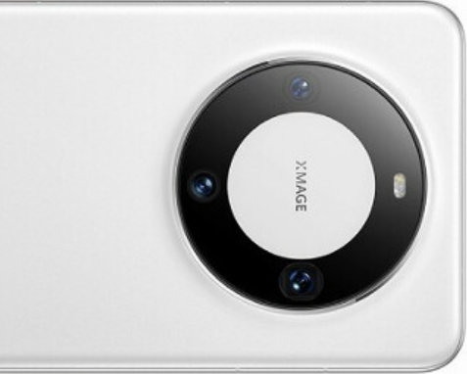
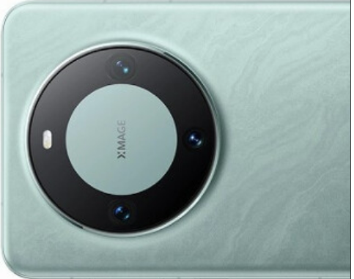
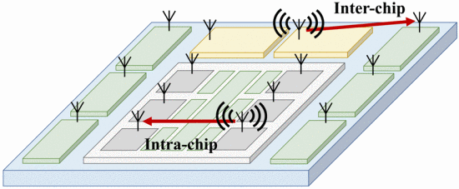
Usage Model 2: Kiss connectivity Communications
Rapid content transfer between a portable /mobile device (e.g., tablet, smart phone) and a fixed device or between two portable/mobile devices within a ultra short separation
Assumption: 1:1
Fast link setup: < 100msec
Transaction time: <1sec
Ultra short link distance: <10cm
Very low power consumption for portable/mobile device: < 400mW
Target data rate: 10 Gbps
@ 70% MAC-App efficiency | Size | Data rate | 11ad Device
4K UHD movie | 60 GB | 1.1 min @ 10Gbps | 11.4 min@1Gbps
HD movie | 5 GB | 5.7 sec @ 10Gbps | 57.1 sec @ 1Gbps
SD movie | 1.5 GB | 1.7 sec @ 10Gbps | 17.1 sec @ 1Gbps
Picture library | 1 GB | 1.1 sec @ 10Gbps | 11.4 sec @ 1Gbps
4K movie trailer | 1.2 GB | 1.4 sec @ 10Gbps | 13.7 sec @ 1Gbps
HD movie trailer | 100 MB | 0.1 sec @ 10Gbps | 1.1 sec @ 1Gbps
E-magazine | 250 MB | 0.3 sec @ 10Gbps | 2.8 sec @ 1Gbps
exchange Movie, video/audio clip, picture library, etc.

Slide 6
Usage Model 3: Augmented Reality/Virtual Reality Headsets and Other High-End Wearables
Pre-Conditions:
The high-speed wearable devices (e.g. augmented reality/virtual reality headsets, high-def glasses, etc.) may be widely used in the future together with its managing device (e.g. gaming console, smartphone, etc.)
All desired media content and control signal are needed to be transmitted between different devices, including content provisioning device and content consumption device
Application:
Playing games and watching movie, using the high-speed wearable devices, which communicate with the content provisioning devices.
Data rate at ~20 Gbps, latency < 5 ms, jitter <5 ms, PER<10E-2.
Environment:
The high-speed wearable devices may be used at home with less than 4 interference typically, and in public with less than 120 interferences typically.
With un-predictable obstacles, transmission can be LOS or NLOS, with typical distance less than 5m.
Traffic Conditions:
The NLOS communication may must be supported, and the interference from other users are also existed
Devices may be stationary or moving (pedestrian speed)
Use Case:
Example with a family, parents and a child, play a game using AR/VR headsets and a smartphone at home.
At the same time, other computers or smart phones of parents are receiving information from website, like messages, emails, downloading software,
Parents and the child, moves in response to the game
The QoS/QoE requirements of the gaming application are met.

Slide 7
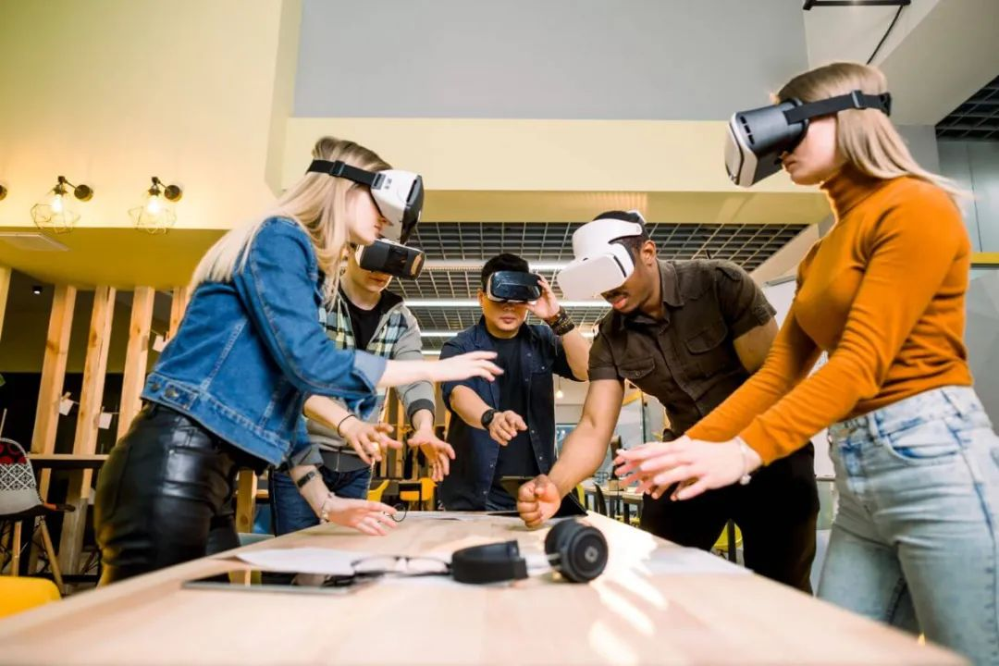
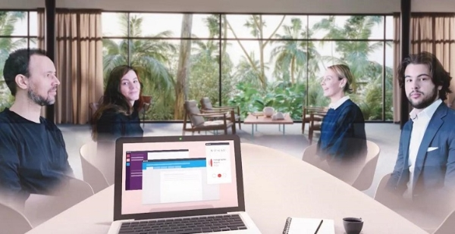
Usage Model 3: Augmented Reality/Virtual Reality Headsets and Other High-End Wearables
High-speed wearables can be used at home or in public
High-speed wearables are supposed to have low level movement
The communication distance is usually < 5 m
High-speed wearables provide close-to-reality user experience with high quality video and audio
Data rate at ~20 Gbps, latency < 5 ms, jitter <5 ms, PER<10E-2
Features | Requirements | Notes
Distance | 5 m
Video Quality | 3D 4K | HDMI 2.0
Range of Motion for head-worn wearable | Neck Roll | 0.17 (s/60deg)
 | Neck Pitch | 0.14(s/60deg)
 | Neck Yaw | 0.13 (s/60deg)
Device mobility | Pedestrian speeds | < 4km/hr

Slide 8
Usage Model 4: Video/Mass-Data Distribution/Video on Demand (VOD) System
Pre-Conditions:
The SLM access module are deployed in ceilings of large room/space.
Multiple user devices have SLM user modules, communicates with the SLM access module.
Application:
The HD video/mass-data can be broadcasted to the multiple users simultaneously.
In a exhibition/gymnasium, multiple screens show the same video.
In a classroom, students watch the same courseware using their own devices.
Users can use VOD system to watch moves/videos that they are interested in.
Environment:
Environment is highly diverse, e.g. waiting place at train station/airport, in flight, train, ship, bus, exhibition, gymnasium, classroom, crowded public place, etc.
A high place installation for SLM access module is recommended because, to avoid obstacles block the mm-wave links, such as furniture, human body on the floor.
The user device can be a mobile potable device, or fixed deployed such as large-screen TV, touch screens in the back of the seat in flight/train, etc.
Transmissions can be LOS or NLOS, with distance <100m.
Traffic Conditions:
There may exist multiple user sets, where each sets has one or more user devices with SLM user modules. Different user sets have varying QoS, reliability, and throughput requirements, some with simply best-effort rates (downloading), others with a certain data rate and QoS requirements(video, VoIP, etc.)
The transmission can be broadcast (one point to multiple point).
The user devices may be fixed or low-mobility during usage.
Use Case:
Users receive the same video/massive-data in broadcast mode.
Users request video/video gaming/audio via VOD system.

Slide 9
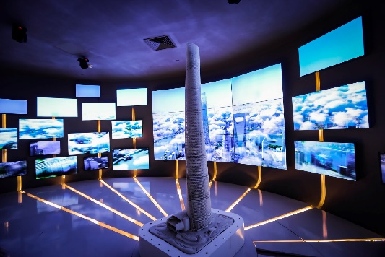

Usage Model 4: Video/Mass-Data Distribution/Video on Demand System
SLM access modules are located in ceilings and seats.
Multiple SLM user modules need to receive the data from access modules simultaneously.
Video streaming, video gaming, audio, downloading courseware in classroom, VOD, etc.
HD-Video distribution in Security control room, exhibition etc.; in-Flight/Train/Ship/Bus entertainment.
E.g., smart classroom requires >4 Gbps
Exhibition
Dubai Light Show
4k/8k video cable replacement

Slide 10
Usage Model 5: Mobile Fronthauling
Pre-Conditions:
The communication between Remote Radio Head (RRH) and Base Band Unit (BBU) uses Common Public Radio Interface (CPRI) or eCPRI, through an optical fiber commanlly.
Application:
In rural areas or disaster areas, optical fibers are unavailable.
In some cases, the wireless network are temporarily provided by drones.
For these cases, cellular networks can be easily establish by using SLM links
The data transfers at ~20 Gbps. High reliability and availability (99.99%).
Environment:
The communication between RRH and BBU are usually in outdoor environment with LOS and distance <200m.
Traffic Conditions:
RRHs and BBU are static.
Number of RRHs may be increased due to traffic load increasing.
Data rate may be increased with larger bandwidth and more streams.
High quality QoS support is necessary to carry real-time traffic such as voice and video.
Use Case:
Mobile operators use SLM modules for front-haul, in areas without optical fiber.
Mobile operators can re-use the SLM technology on RRH to provide wireless service to mobile users.

Slide 11
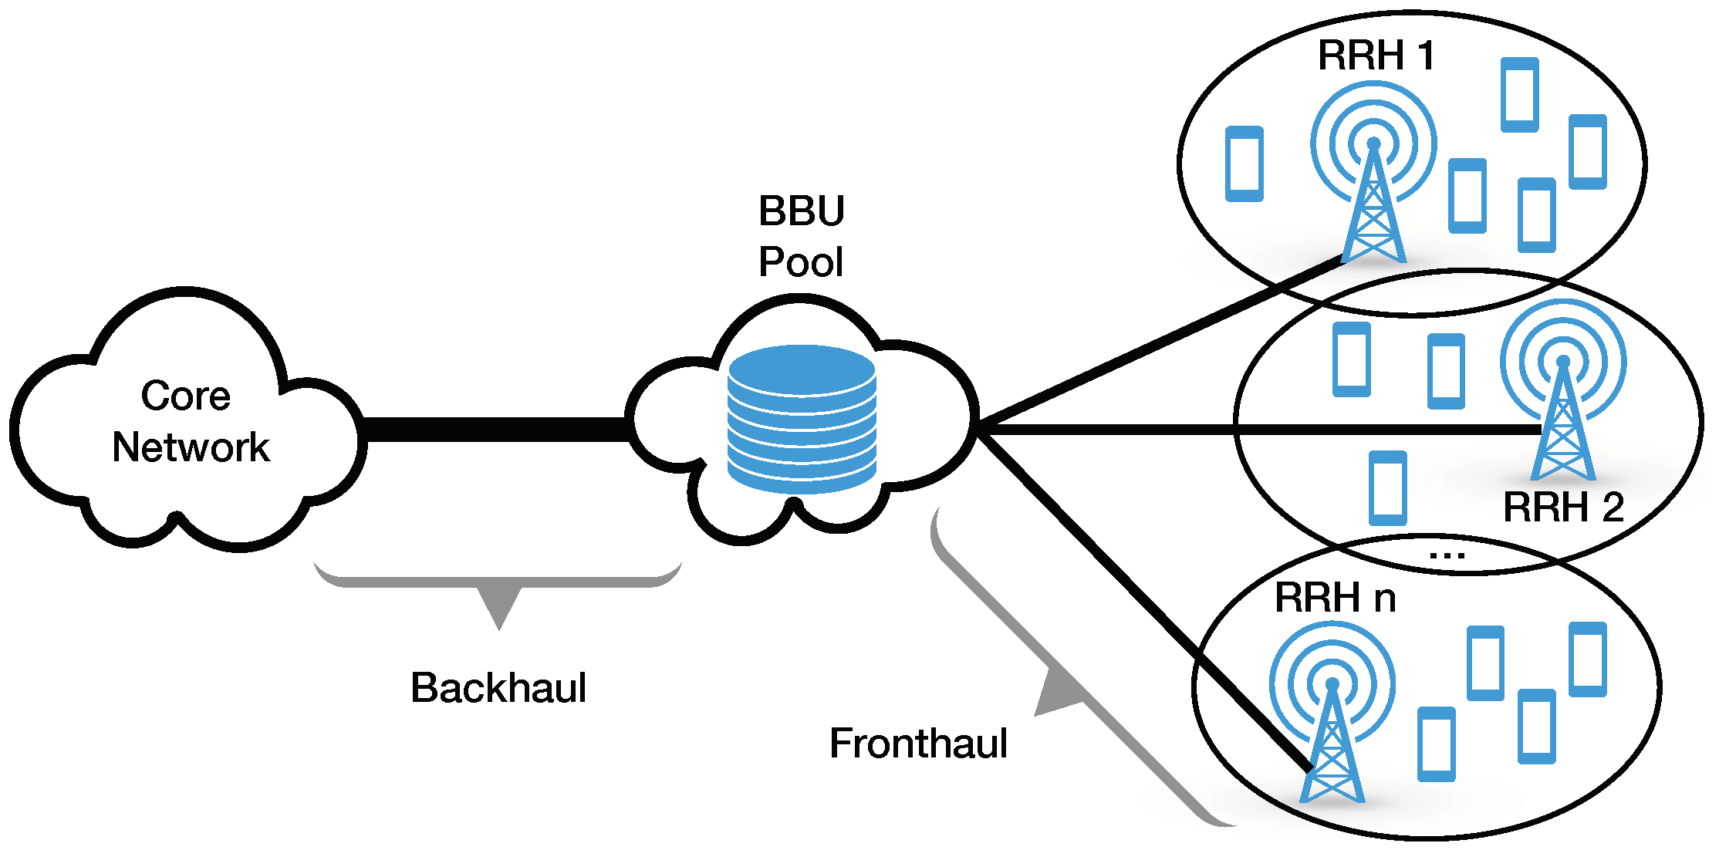
Usage Model 5: Mobile Fronthauling
Requirements
- Provides full rate ~20 Gbps ,
less than 200m LOS @60GHz band
- QoS
- 99.99% of availability

Slide 12
Usage Model 6: Office docking
Pre-Conditions:
In office or at home, mobile device (Notebook, tablet, smartphone, small form factor) may communicate wirelessly with multiple peripheral devices - monitors, camcorders, web cameras, hard drives, printers, Internet AP/Router, etc.
The mobile device may have its own dock/peripherals, like D2D.
Multiple peripherals may share a dock. The communication between the mobile devices and the dock may be wired, but that between the peripherals and the dock can be wireless, and vice versa.
Application:
Support of two monitors of 8K resolution
Wireless support of USB devices with different traffic characteristics: isochronous, human interface and others
Gigabit Ethernet
Mass storage devices
3D webcams
Dynamic composition
Connecting mobile to 2-5 peripheral devices
Mobile device should be able to sustain full working day w/o recharging battery
Connecting multiple mobile source devices to dock
Environment:
In office or at home, such as open space, cubicles, meeting room, and standalone home office usage, where range between mobile, dock and peripherals will typically be < 3m.
Traffic Conditions:
Transmission can be one to one, one to many, and many to one (with shared dock)
Different level of QoS requirements, some with low latency, others with best-effort rates.
Transmission can be unidirectional or bidirectional.
Multiple uncoordinated networks co-exist and interference with each other.
Use Case:
Mobile device is wirelessly connected to a docking station, and/or directly wirelessly connected to multiple peripherals
Mobile device may be wirelessly connected to other mobile devices, wireless LAN, Bluetooth and other wireless radio simultaneously.
Dense office environment with multiple mobile devices and multiple docks, where there may exist a mesh connection between devices and docks with one to one , one to many, and many to one.
The QoS requirements of different data flows may vary , such as latency and throughput requirements (monitors under productivity applications, Dynamic composition, HID)

Slide 13
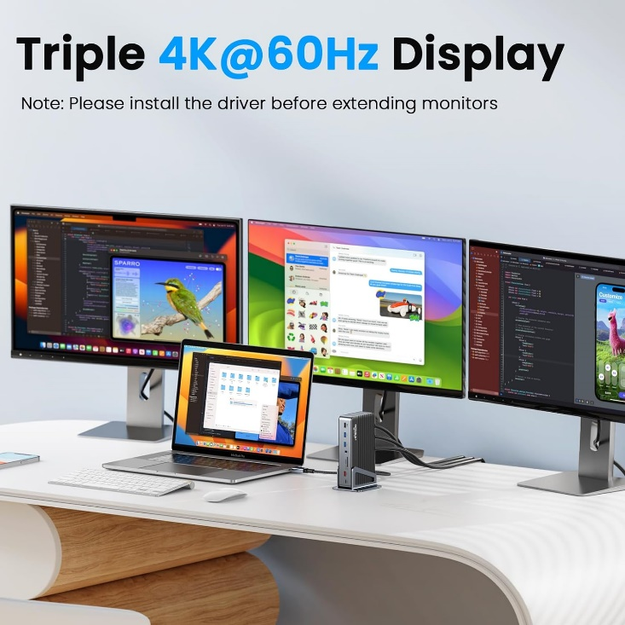
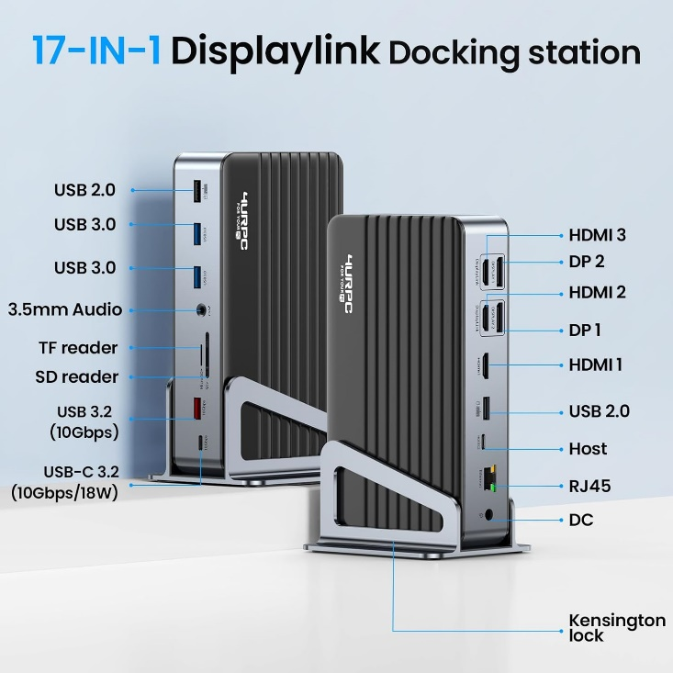
Usage Model 6: Office docking examples
Supply features 3 HDMI ports(Max 8K@30Hz), 2 DisplayPorts(Max 4K@60Hz), Gigabit Ethernet Port, 1xUSB-C 3.2 Port(10Gbps/18W Charging), 1 x USB-A 3.2 Ports(10Gbps), 2 x USB-A 3.0 Ports(5Gbps), 2 x USB-A 2.0 Ports, SD/microSD card slots, 3.5 mm audio/Mic port, a DC input, and a Kensington lock.
USB and HDMI cables replacement is also important use case for mmWave

